Slide 2
Notes:
Sometimes it’s tempting to step outside your area of expertise – you sold a client’s home in your usual area and they want you to help them buy one somewhere else, for example, or your residential client is looking for a business location.
If you step outside your area of expertise, you are at greater risk of having a claim made against you. This presentation will provide some examples of where licensees have overstretched their bounds and were taken to task for it.

Slide 3
Notes:
Different kinds of properties have different requirements that you may not be aware of if you don’t usually work with them.
Country residential properties can have very specific challenges that you might need to make your client aware of. As do condominiums and manufactured homes.
Commercial properties require a great depth of knowledge that you just may not have garnered as a residential licensee.
Geographic areas often have specific local bylaws that affect properties, or there may be other things going on in the area that you don’t know about.

Slide 4
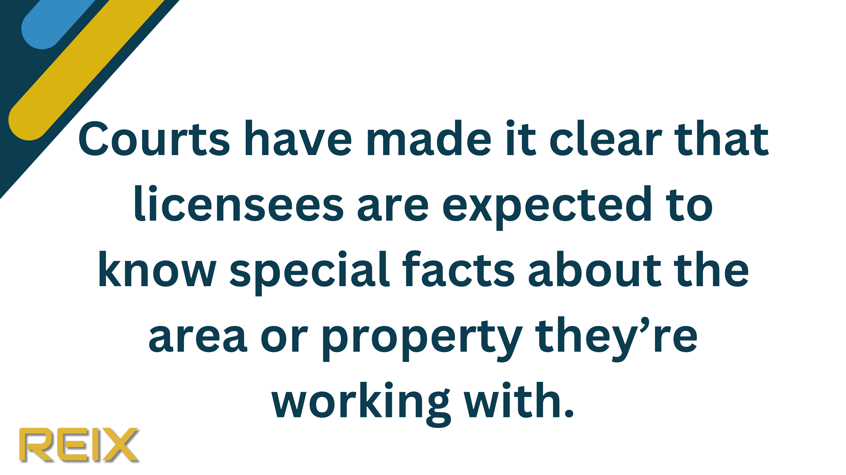
Notes:
Not knowing is not an acceptable excuse!
Clients sometimes make claims or file lawsuits against licensees/registrants who’ve acted outside their area of expertise.
It’s your responsibility to know pertinent facts about any property you’re dealing with.

Slide 5
Notes:
In this first example, it was well known that termites were a problem in the general area of the subject property.
The seller’s agent wasn’t aware of this issue and described the home as being in “move-in condition,” although it was heavily infested with termites. The court found that the agent should have known that the home was in a heavily infested termite area and that his “standard of performance was not to be admired.” He was found negligent.

Slide 6
Notes:
For this agent, 15% of their business was in selling manufactured homes, but they said they were unaware of the requirement for a CSA label on such homes.
The licensee was found liable for not informing the client of the need for the label.

Slide 7
Notes:
Licensees/registrants are not expected to be experts in tax nor are they expected to make any representations or give any advice with respect to taxes. You should advise your clients to seek advice from an accountant or tax expert for their questions.
In this example, the agent incorrectly told the buyer that the subject property was outside the area that required paying the foreign buyer’s tax.
Never give tax advice. If you’re not sure, advise your client to consult an expert. Keep a record that you did so.

Slide 8
Notes:
If you’re not accustomed to working with condo properties, there’s a lot of information and documentation that you might not be familiar with such as bylaws, parking/storage lockers, estoppel certificates, legislation etc.
In this case, the licensee wasn’t aware of an age limit set by the condo board, which required residents to be aged 55 or older.
The buyer was only 50, so couldn’t live in the property for five more years and was subject to monthly fines until they sold or moved out. The buyer made a claim against the buyer’s agent for putting them into a property that was not suitable.
If you’re working for a buyer or seller of a condo unit, you should familiarize yourself with important information about the unit and complex.

Slide 9
Notes:
There are steps you can take to avoid being the subject of a claim like the ones we’ve talked about.
These include:
Educating yourself, referring the client to an expert agent when required and investigate thoroughly should you decide to assist your client. Make sure you know that what you are saying is accurate, because you will be held accountable to it.

Slide 10
Notes:
Educate yourself.
Don’t assume you know everything if you’re considering moving into an area of business or a locale that’s new to you.
You can find a mentor or a specialist who will teach you,
or you can take courses on specialized properties.

Slide 11
Notes:
Refer the client to an expert.
Both you and your client will be better served if you immediately refer them to another agent with the right expertise. You eliminate the possibility of making a costly mistake, and the client is better served by a licensee or registrant who knows the ropes.

Slide 12
Notes:
If you’re unsure of anything, investigate it thoroughly.
Start by asking your managing broker – they may have specialized knowledge or be able to point you in the right direction.
Check out applicable municipal records, rules and regulations. What’s true in one municipality is not necessarily so in the one next to it.
Do your research.
Consult the REIX, RECA and/or SREC websites to see if it touches on the issue at hand.

Slide 13
Notes:
Thank you for your time today! If you have more questions please refer to reix.ca or contact REIX at admin@reix.ca.

